Slide 1

Neural Network-Based Fault Identification and Classification Using RBFNN and FNN Models
Advisor: Prof. Ryan Lian
Presenter: Prayoga & Abdillah
Date: 2024/08/28
Notes:
Good afternoon professor, today we’ll present the workflow of a fault resistance simulation in transmission line circuit. Then we can identify and classify these faults using advanced neural network techniques.

Slide 2

Learned Materials: 1. Time series forecasting
2. Exploratory Data Analysis (EDA)
3. Hyperparameter 4. Feature Engineering
Notes:
Previously, we’ve learned some topics such as….Mostly, We’ve practiced these topics using jupyter notebook. And now we’ve tried to implement another topic which is multilabel classification on MATLAB both code and simulation

Slide 3
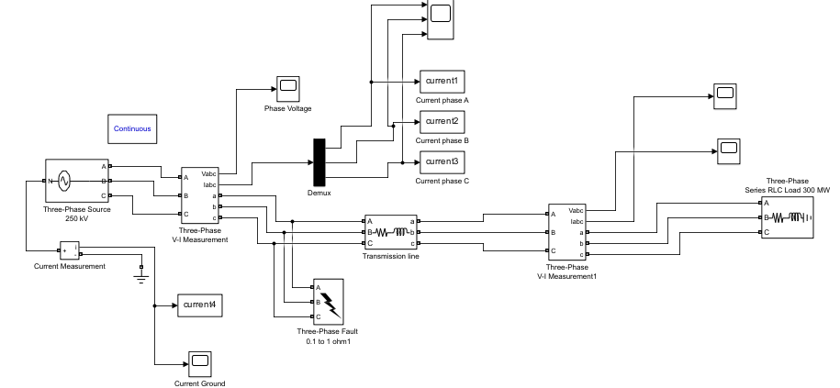
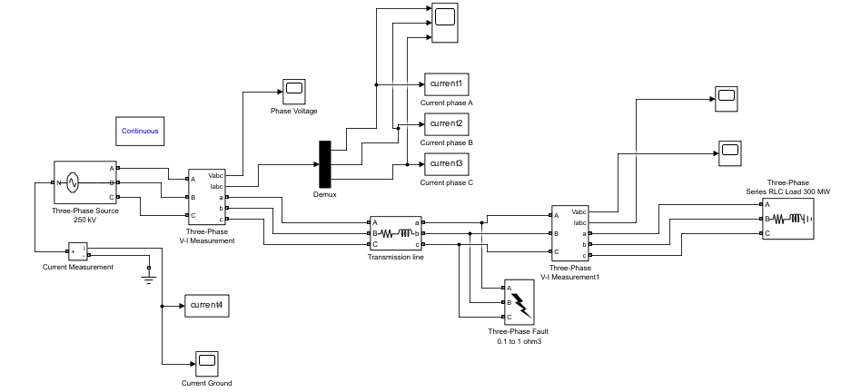
Fault Identification in Three-Phase Transmission Line
Objective:
to predict max coefficient of each phase during fault conditions.
Fault ground resistance:
0.1 – 1 ohm (0.1 ohm increment)
Type of fault :
RST-G - R-T
RST - S-T
RS-G - R-G
RT-G - S-G
ST-G - T-G
R-B - No fault
Fault Location:
- Before transmission line
- After transmission line
Output value for each phase:
1 = fault
0 = no fault
Note: In high-voltage systems, even a small fault resistance can result in extremely large fault currents. Since the wavelet transform captures the energy and intensity of these currents, the coefficients can be quite large as well.
Notes:
Let's start with an overview of the circuit. We have a powerful voltage source of 250 kV, driving the electricity through the transmission line to handle power—300 megawatts. Now, the main focus here is on fault resistance, which we've set to vary between 0.1 and 1 ohm. These settings will help us simulate different fault conditions before and after the transmission line then produce max coefficient of each phase during that fault conditions.
P redicting the maximum coefficient of each phase during fault conditions helps in:
Quickly detecting and identifying faults.
Designing effective protection systems.
Enhancing the reliability and safety of the power transmission network.
Providing critical data for machine learning models to automate fault diagnosis.

Slide 4
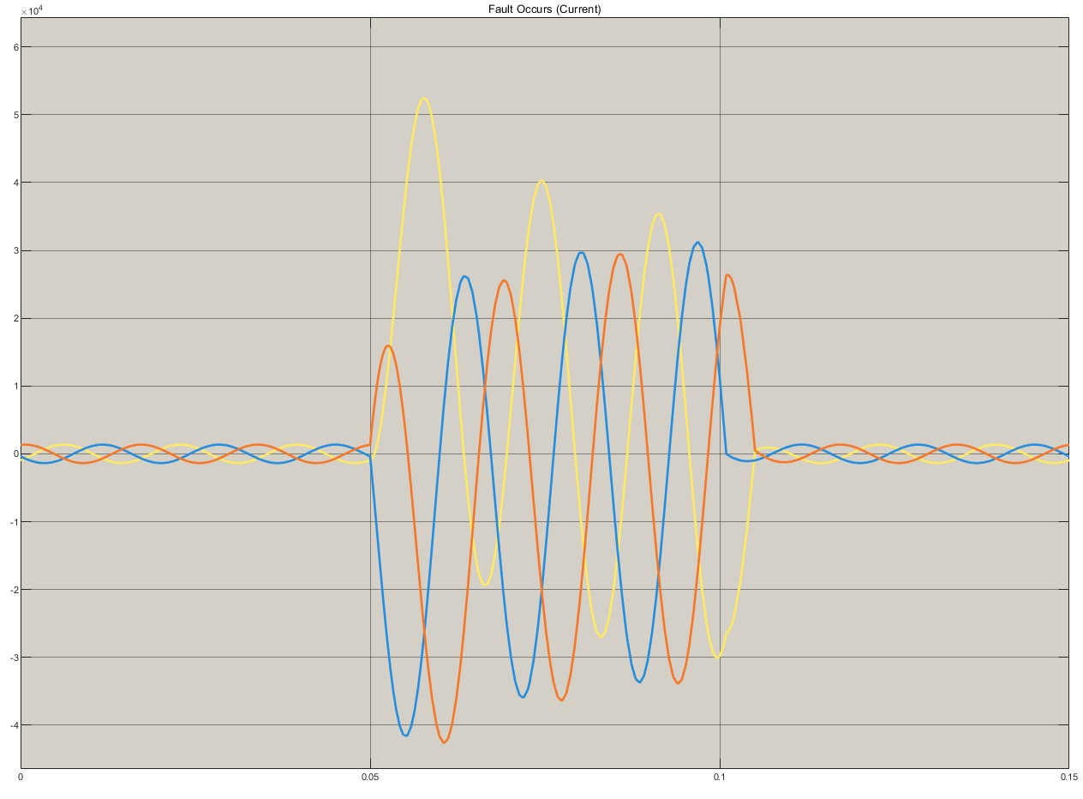

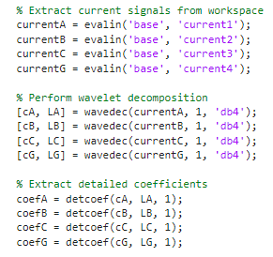
Current waveforms during fault condition:
Wavelet transform
Notes:
This graph display the current waveforms during a fault condition. The different colors represent the currents of each phases and the sudden changes in the waveforms indicate the impact of the fault on the system.
Then we used wavelet transform to analyze the current waveforms, and the maximum coefficient value obtained from this transformation
*wavelet transform is a powerful feature extraction tool, especially in the context of signal processing tasks

Slide 5
Data X (Input)
Data y (Output)
Total data : 240 data
Output value for each phase:
1 = fault
0 = no fault
Notes:
After running the program, we’ve generated a dataset that will be used for further processing, specifically as a dataset for multilabel classification.
We have a total of 240 data points. Then we will extract the first four columns of maximum coefficients as the input and the next four columns of output values as the output.
The coefficients generated by a wavelet transform do not directly represent the physical current but rather how the signal changes over time. High coefficients mean the signal has sharp changes or high energy in certain frequency bands. Fault Current Calculation:
In a high-power system, the fault current can be calculated using Ohm’s law I=V / Z (250kV / 0.1 ohm) This is an extremely high current, which could easily result in large wavelet coefficients.
Wavelet Coefficients:
The wavelet coefficients represent the energy or intensity of certain features in your current signal. If your current signals are peaking in the range of millions of amperes, it's not unreasonable for the corresponding wavelet coefficients to be in the range of 10710^7107

Slide 6
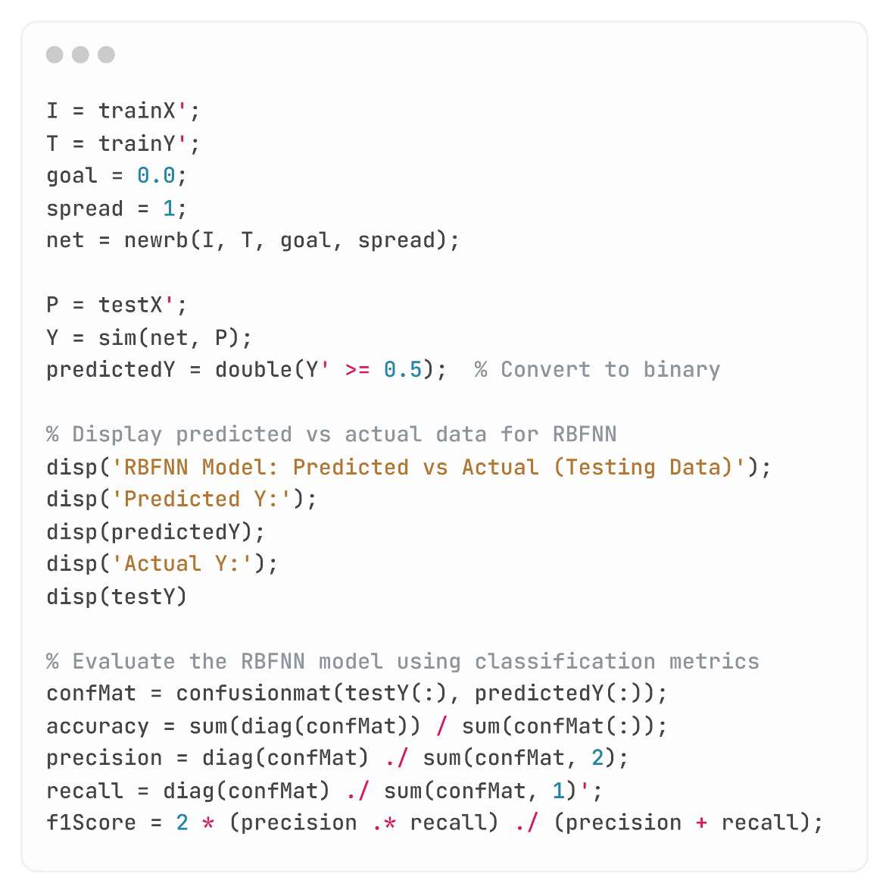
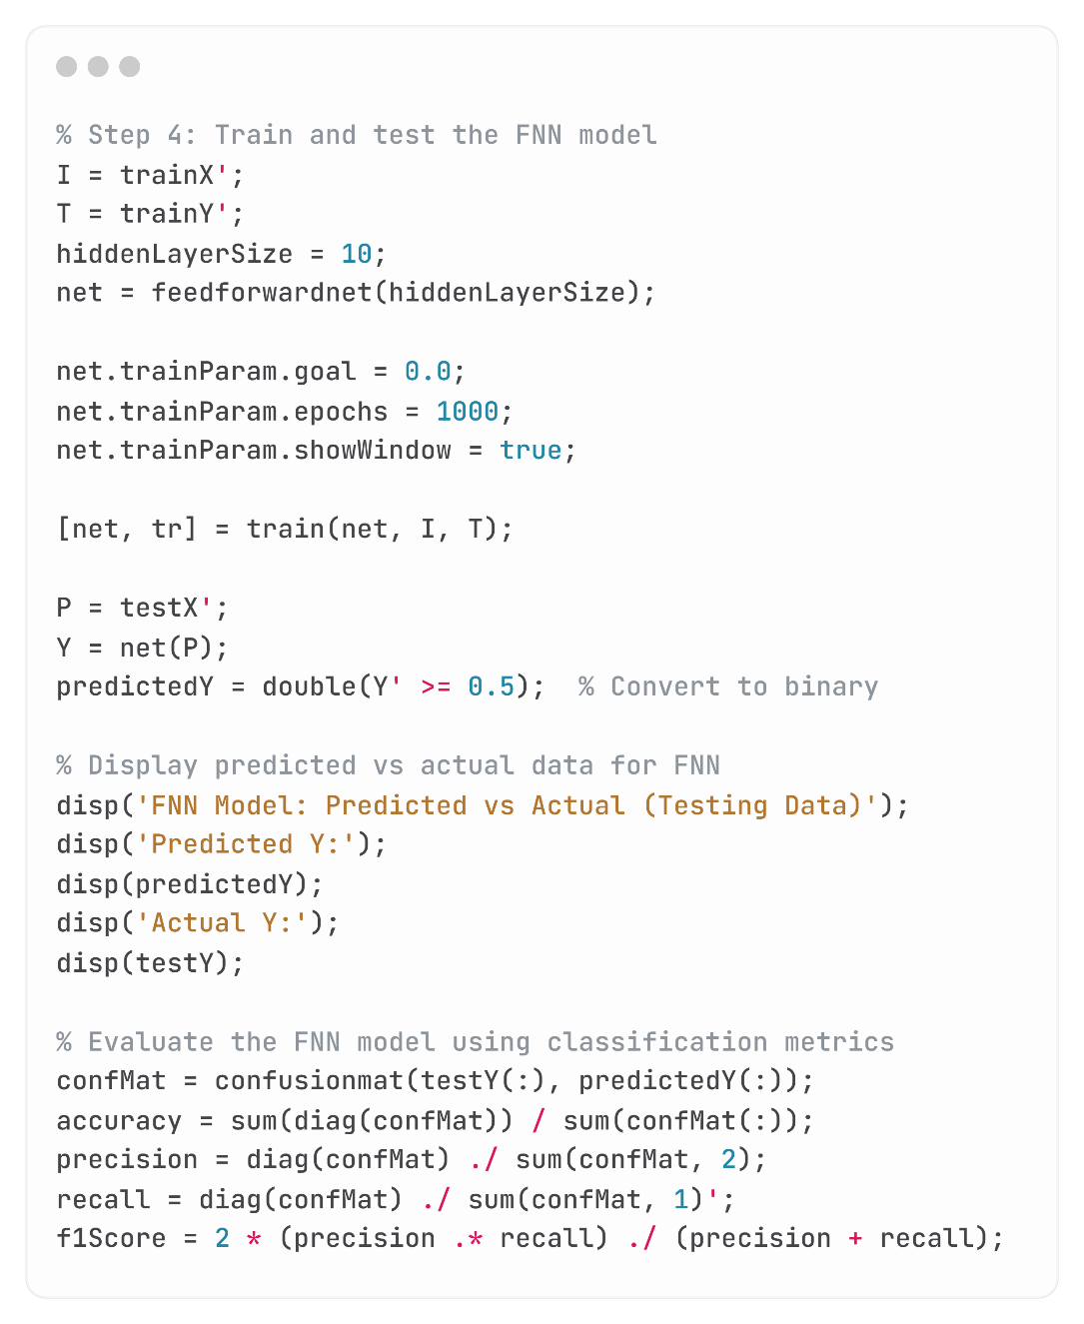
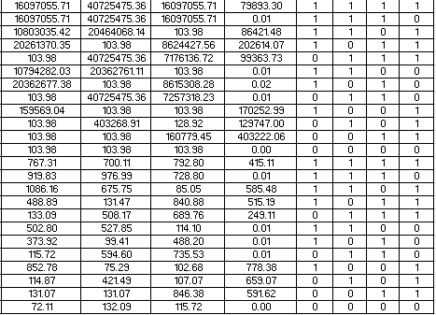
MATLAB Workflow for Multilabel Classification
Data preprocessing: - Feature Extraction
- Split dataset (Training – Testing)
Neural Network Models: - RBFNN
- FNN
(Training & Testing)
Multilabel Classification
Result
Metrics
Evaluation
Load Dataset
X (input)
y (output)
Split Data: Training 70% = 168
Testing 30 % = 72
Notes:
Here is the MATLAB workflow for multilabel classification:
We load the dataset.
Next, we preprocess the data, including feature extraction and splitting the data into training and testing sets.
Then, we build and train neural network models (RBFNN and Feedforward NN models) and test them.
After that, we generate the results.
Finally, we evaluate the metrics to assess the error of the process.

Slide 7
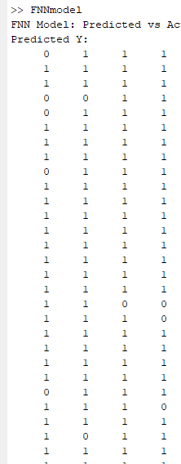
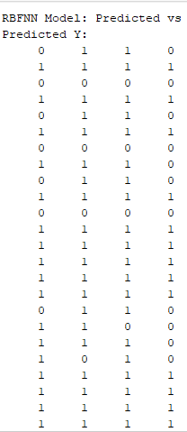
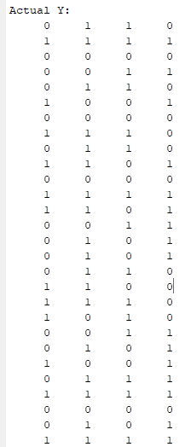
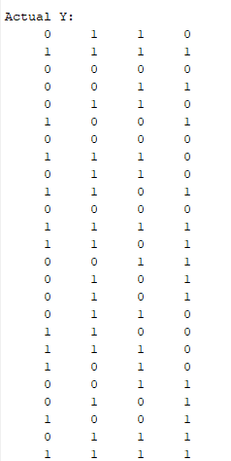
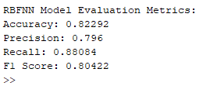
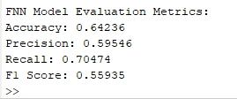
Multilabel Classification Result
RBFNN model
FNN model
Notes:
Here are the multilabel classification results. We display the predicted versus the actual values for each model.
Based on the evaluation metrics, the RBFNN model performs better than the FNN model. So, we conclude, this model is more suitable for multilabel classification in this simulation case

Slide 8
THANK YOU

